Slide 1
MDF#AZWELLPLUS
10,11 Oct 2024
Generative AI Workshop

Slide 2
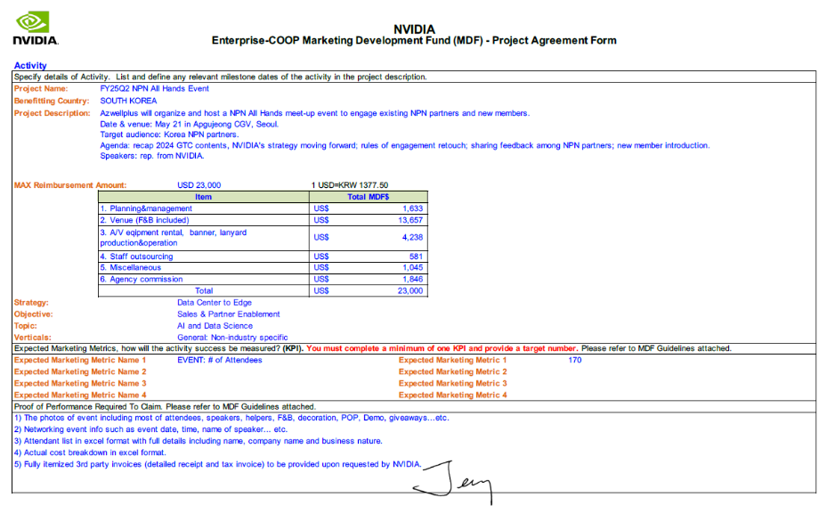
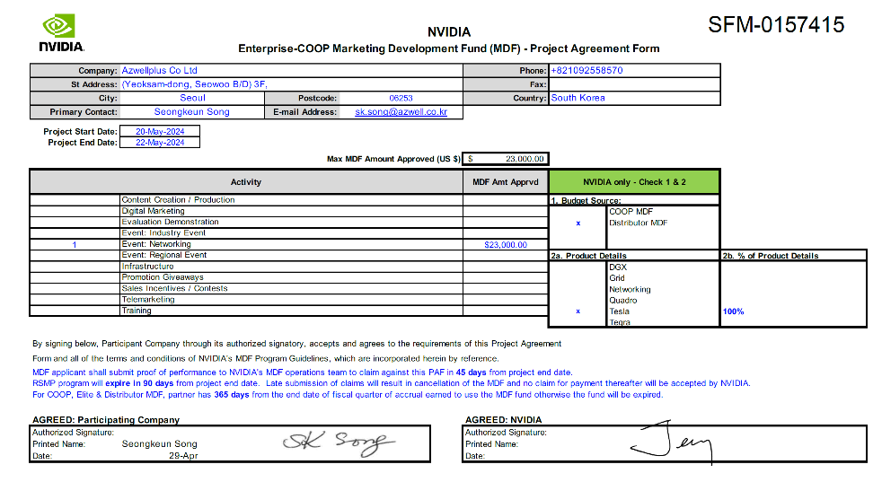
PAF

Slide 3
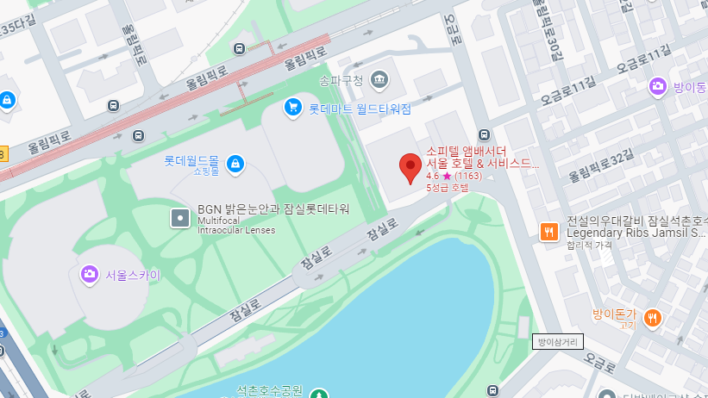
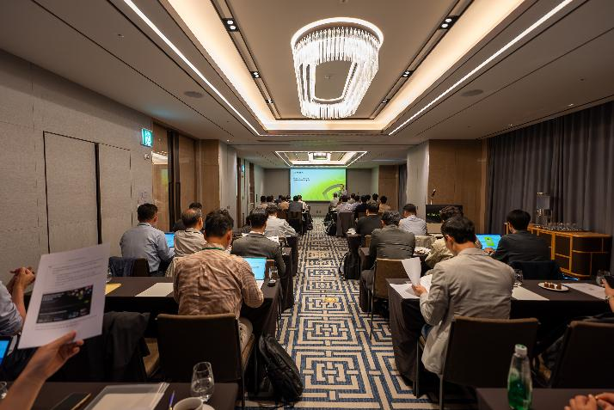
Overview
일시 : 2024년 10월 10일(목) 09:00~18:00 / 2024년 10월 11일(금) 09:00~20:00
장소 : 소피텔 엠베서더 콩코드룸 I II (6층)
타이틀 : Generative AI Workshop
참석 인원 : 46
소피텔
6층 콩코드룸

Slide 4
Agenda - Day 1
Time | Session |  | Speaker
08:30 – 09:00 | Registration
09:00 - 10:00 | Welcome & NVIDIA GTM |  | Brian Jeon
10:00 - 10:45 | Introduction to Generative AI and Large Language Models (Instructor-led) |  | Ku Hlyung Jung
10:45 - 11:00 | Break Time 1
11:00 - 12:00 | GenAl Use Cases - Activity-Based Industries Carousel |  | Charles Kim, Ku Hyun Chung
12:00 - 13:00 | Lunch
 | Sales Breakout |  | SE Breakout
13:00 - 14:30 | Targeting GenAI Opportunities – Group Activity | Brian Jeon | Infrastructure Considerations for GenAI Solutions | Charles Kim
14:30 - 14:45 | Break Time 2
14:45 - 16:15 | Driving GenAI Success with NVIDIA-Based Solutions (Instructor-led) | SangOk Han | GenAI development with NVIDIA Full-stack AI Platform | Ku Hyung Chung
16:15 - 16:30 | Break Time 3 (merge)
16:30 - 17:15 | Interactive Demo & NVIDIA NGC Catalog Activity |  | Charles Kim
17:15 - 17:30 | Joint Wrap Up |  | Brian Jeon

Slide 5
Agenda - Day 2
Time | Session | Speaker
08:30 – 09:00 | Registration
09:00 - 09:30 | Welcome Back | Brian Jeon
09:00 - 11:00 | Addressing the Buyer’s Journey (Instructor-led) | Brian, Charles
11:00 - 11:15 | Break Time 1
11:15 - 12:15 | Processes to Influence and Accelerate Customer Decisions (Instructor-led) | Charles
12:15 - 13:15 | Lunch
13:15 - 14:30 | Activity-Based Case Study Part 1 – Team Meeting | SangOk, Brian, Charles
14:30 - 16:00 | Activity-Based Team Case Study Part 2 – Role Play | SangOk, Brian, Charles
16:00 – 16:15 | Break Time 2
16:15 - 17:00 | Group Feedback & Discussion
17:00 – 17:30 | Final Reflections & Farewell Address – NVIDIA and Dell, “Better Together” | Brian Jeon

Slide 6
참석 인원
참석 인원 | 46명
회사명 | 참석 인원
NVIDIA | 4
에즈웰 에이아이 | 2
BNINC | 4
ICRAFT | 2
MAYMUST | 2
MDS테크 | 2
MKISCORE | 4
Uclick | 4
동국시스템즈 | 2
디에스앤지 | 2
리더스시스템즈 | 4
베이넥스 | 2
씨이랩 | 2
아이커머 | 2
에스넷시스템 | 2
에임투지 | 2
제스프로 | 2
한국인프라 | 2

Slide 7
현장 제작물

Slide 8

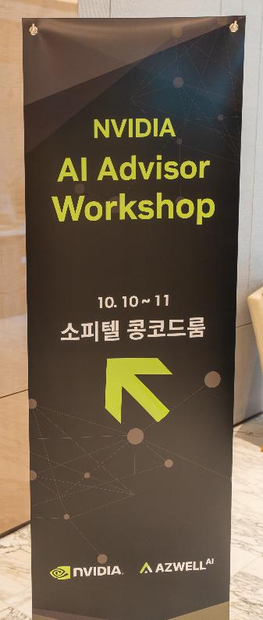
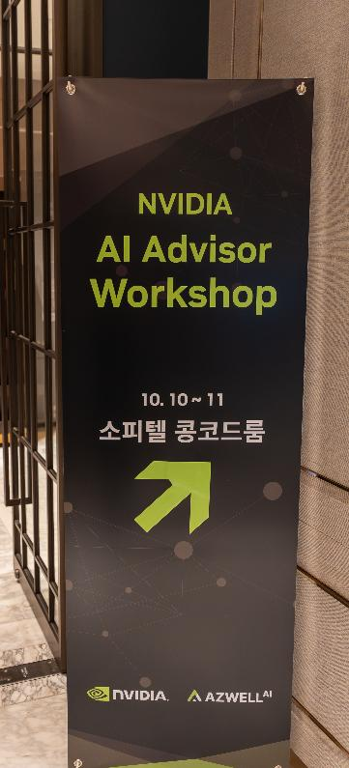
제작물
디렉션 배너 – 2ea

Slide 9

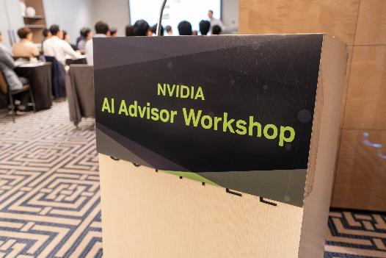
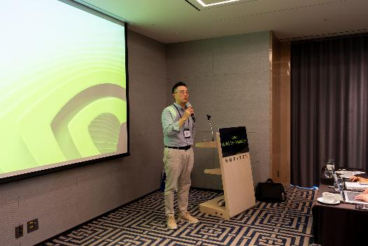
제작물
포디움 – 2ea

Slide 10

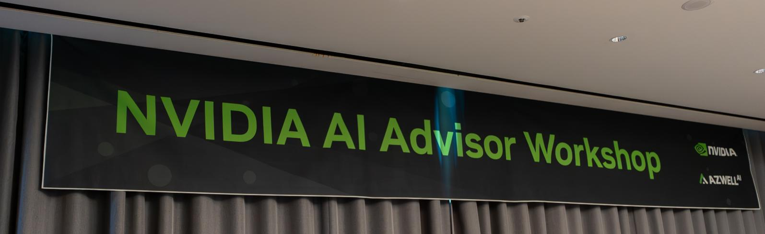
제작물
현수막 – 2ea

Slide 11

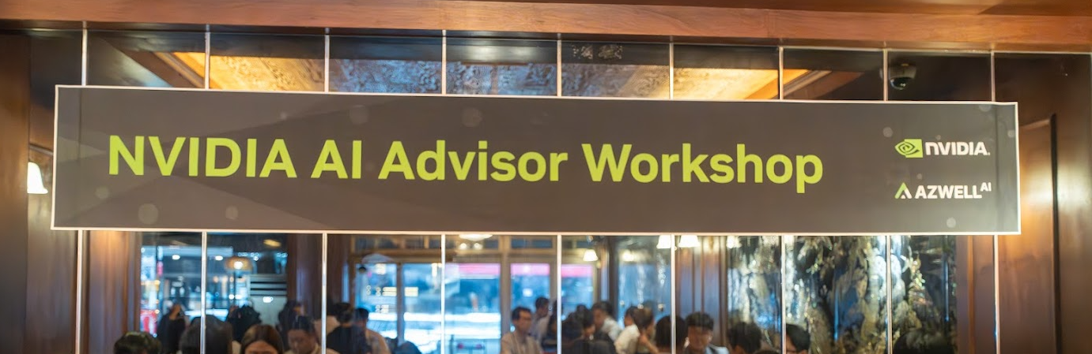
제작물
현수막 – 2ea

Slide 12

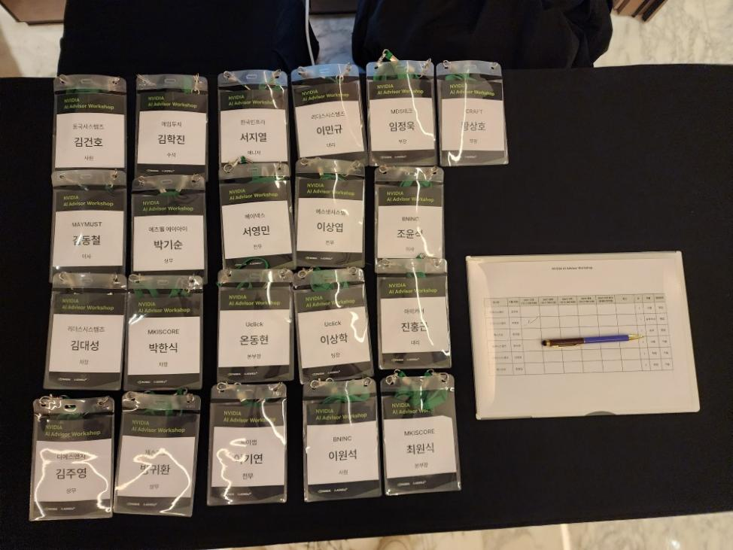
제작물
네임택 – 60ea

Slide 13
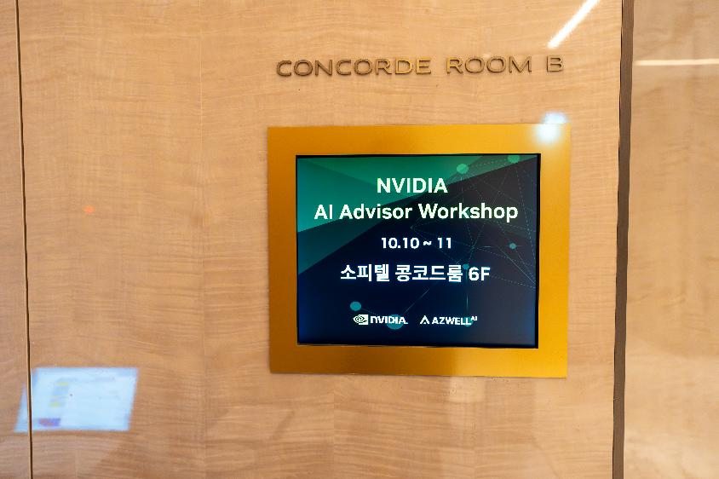
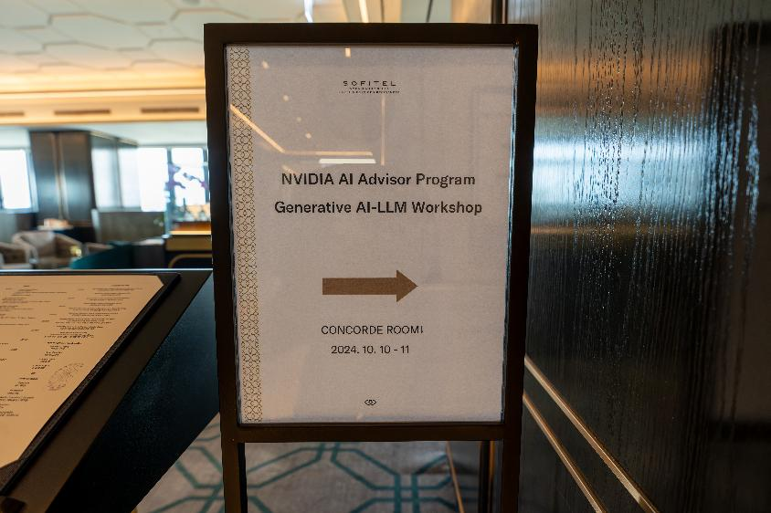
제작물
안내

Slide 14
F&B

Slide 15
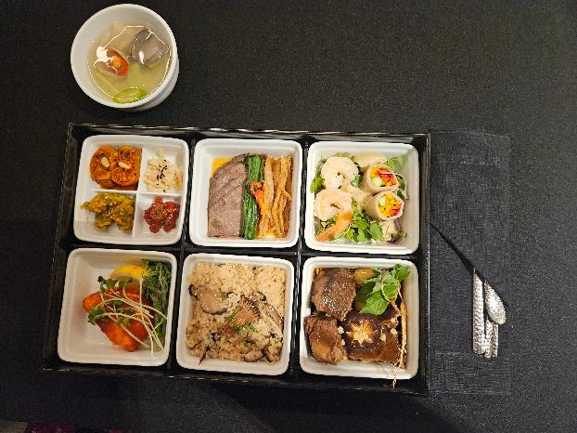
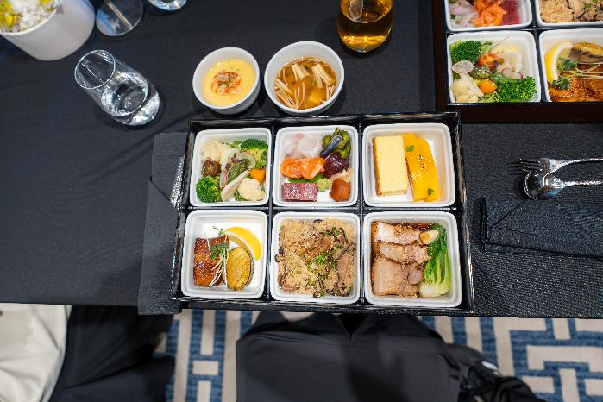
F&B
런치 50인분
호텔 런치 | 50인분 x 2일
제공 시간 | 양일 12:30 / 각 1회
제공 방법 | 호텔 서브

Slide 16
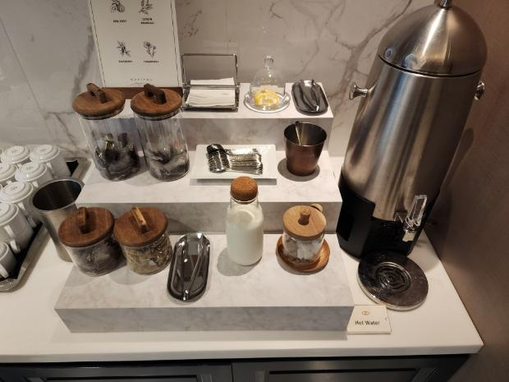
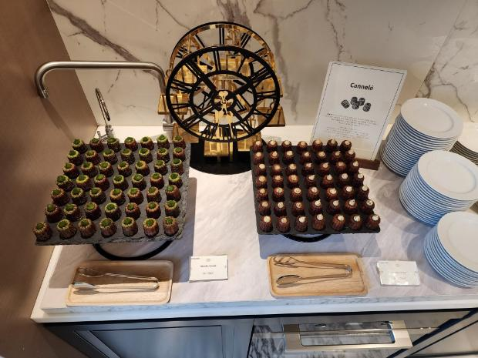
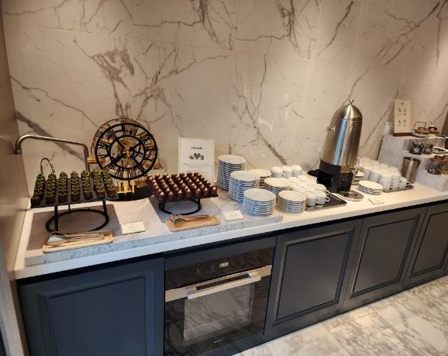
F&B
커피 & 쿠키
호텔 F&B | 50인분
제공 시간 | 오전 / 오후 2회
제공 방법 | 홀텔 서브

Slide 17
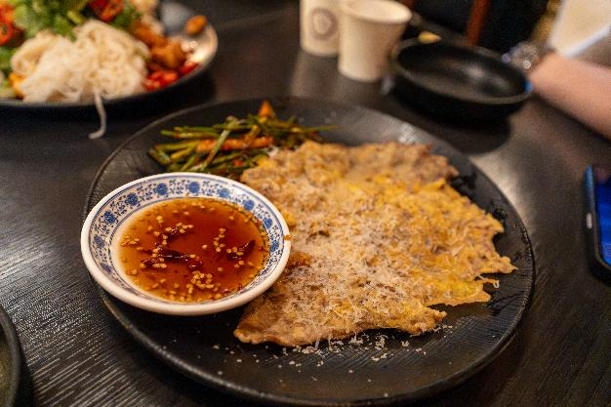
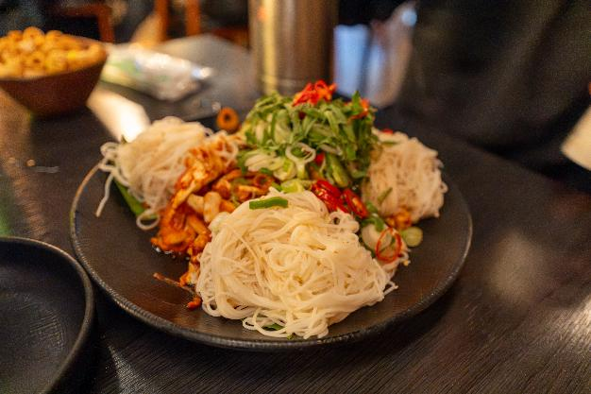
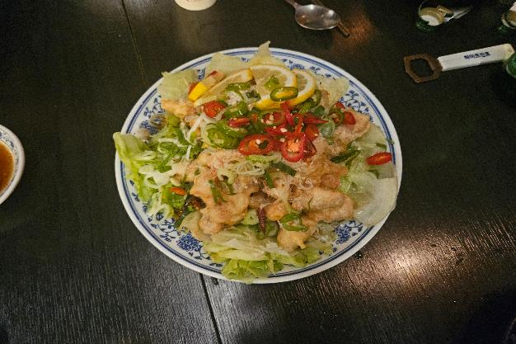
F&B
저녁 디너
골뱅이 소면 | 50인분
육전 | 50인분
유린기 | 50인분
제공 시간 | 18:00
제공 방법 | 매장 서브

Slide 18
Session Day-1

Slide 19
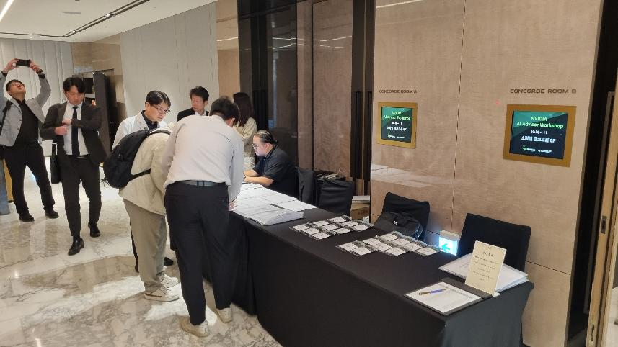
Session
Time | Session
08:30 – 09:00 | Registration
09:00 - 10:00 | Welcome & NVIDIA GTM
10:00 - 10:45 | Introduction to Generative Al and Large Language Models
10:45 - 11:00 | Break Time 1
11:00 - 12:00 | GenAl Use Cases - Activity-Based Industries Carousel
12:00 - 13:00 | Lunch
 | Sales Breakout | SE Breakout
13:00 - 14:30 | Targeting GenAI Opportunities – Group Activity | Infrastructure Considerations for GenAI Solutions
14:30 - 14:45 | Break Time 2
14:45 - 16:15 | Driving GenAI Success with NVIDIA-Based Solutions (Instructor-led) | GenAI development with NVIDIA Full-stack AI Platform
16:15 - 16:30 | Break Time 3 (merge)
16:30 - 17:15 | Interactive Demo & NVIDIA NGC Catalog Activity
17:15 - 17:30 | Joint Wrap Up
Registration

Slide 20
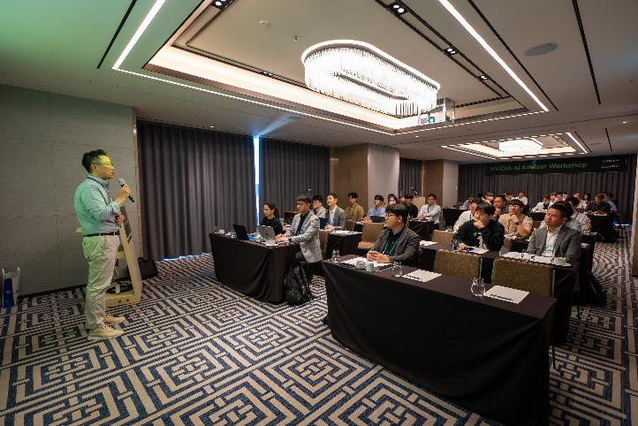
Session
Time | Session
08:30 – 09:00 | Registration
09:00 - 10:00 | Welcome & NVIDIA GTM
10:00 - 10:45 | Introduction to Generative Al and Large Language Models
10:45 - 11:00 | Break Time 1
11:00 - 12:00 | GenAl Use Cases - Activity-Based Industries Carousel
12:00 - 13:00 | Lunch
 | Sales Breakout | SE Breakout
13:00 - 14:30 | Targeting GenAI Opportunities – Group Activity | Infrastructure Considerations for GenAI Solutions
14:30 - 14:45 | Break Time 2
14:45 - 16:15 | Driving GenAI Success with NVIDIA-Based Solutions (Instructor-led) | GenAI development with NVIDIA Full-stack AI Platform
16:15 - 16:30 | Break Time 3 (merge)
16:30 - 17:15 | Interactive Demo & NVIDIA NGC Catalog Activity
17:15 - 17:30 | Joint Wrap Up
Welcome & NVIDIA GTM

Slide 21
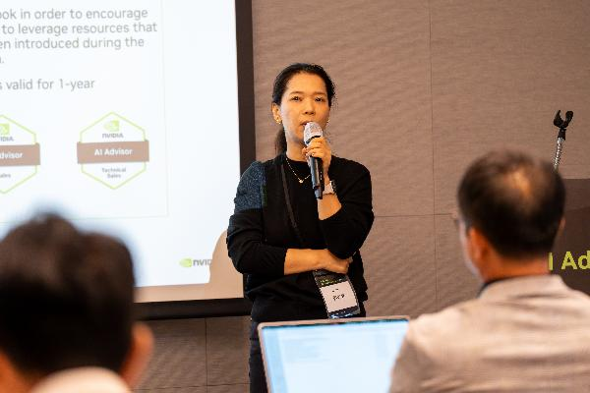
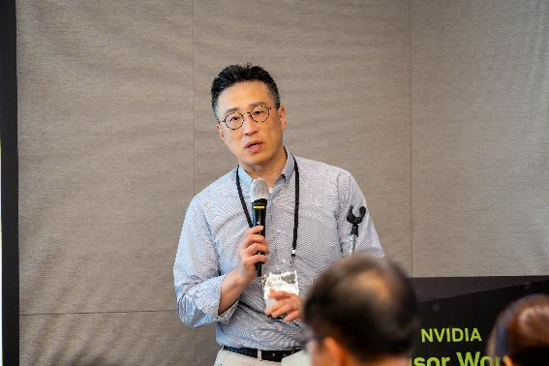
Session
Time | Session
08:30 – 09:00 | Registration
09:00 - 10:00 | Welcome & NVIDIA GTM
10:00 - 10:45 | Introduction to Generative Al and Large Language Models
10:45 - 11:00 | Break Time 1
11:00 - 12:00 | GenAl Use Cases - Activity-Based Industries Carousel
12:00 - 13:00 | Lunch
 | Sales Breakout | SE Breakout
13:00 - 14:30 | Targeting GenAI Opportunities – Group Activity | Infrastructure Considerations for GenAI Solutions
14:30 - 14:45 | Break Time 2
14:45 - 16:15 | Driving GenAI Success with NVIDIA-Based Solutions (Instructor-led) | GenAI development with NVIDIA Full-stack AI Platform
16:15 - 16:30 | Break Time 3 (merge)
16:30 - 17:15 | Interactive Demo & NVIDIA NGC Catalog Activity
17:15 - 17:30 | Joint Wrap Up
Introduction to Generative Al
and Large Language Models

Slide 22
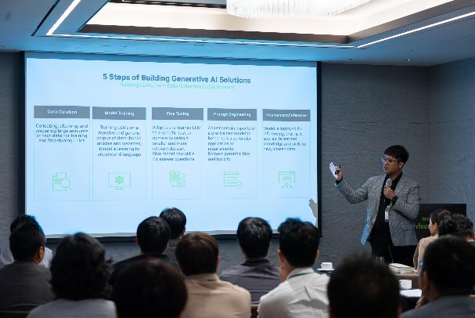
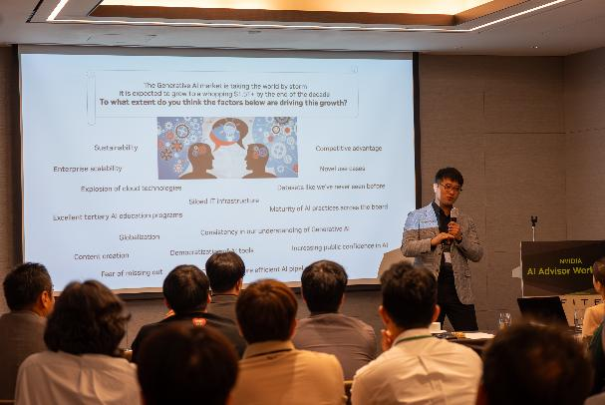
Session
Time | Session
08:30 – 09:00 | Registration
09:00 - 10:00 | Welcome & NVIDIA GTM
10:00 - 10:45 | Introduction to Generative Al and Large Language Models
10:45 - 11:00 | Break Time 1
11:00 - 12:00 | GenAl Use Cases - Activity-Based Industries Carousel
12:00 - 13:00 | Lunch
 | Sales Breakout | SE Breakout
13:00 - 14:30 | Targeting GenAI Opportunities – Group Activity | Infrastructure Considerations for GenAI Solutions
14:30 - 14:45 | Break Time 2
14:45 - 16:15 | Driving GenAI Success with NVIDIA-Based Solutions (Instructor-led) | GenAI development with NVIDIA Full-stack AI Platform
16:15 - 16:30 | Break Time 3 (merge)
16:30 - 17:15 | Interactive Demo & NVIDIA NGC Catalog Activity
17:15 - 17:30 | Joint Wrap Up
GenAl Use Cases -
Activity-Based Industries Carousel

Slide 23
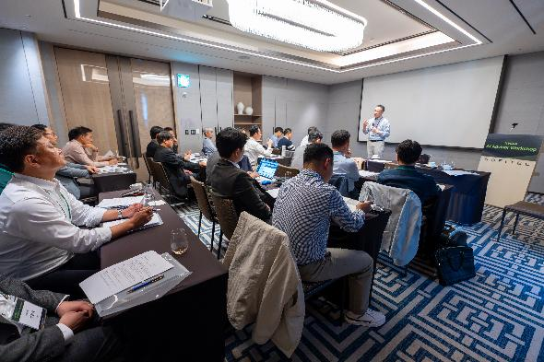
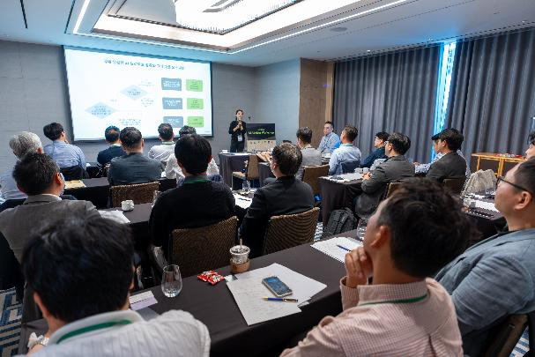
Session
Time | Session
08:30 – 09:00 | Registration
09:00 - 10:00 | Welcome & NVIDIA GTM
10:00 - 10:45 | Introduction to Generative Al and Large Language Models
10:45 - 11:00 | Break Time 1
11:00 - 12:00 | GenAl Use Cases - Activity-Based Industries Carousel
12:00 - 13:00 | Lunch
 | Sales Breakout | SE Breakout
13:00 - 14:30 | Targeting GenAI Opportunities – Group Activity | Infrastructure Considerations for GenAI Solutions
14:30 - 14:45 | Break Time 2
14:45 - 16:15 | Driving GenAI Success with NVIDIA-Based Solutions (Instructor-led) | GenAI development with NVIDIA Full-stack AI Platform
16:15 - 16:30 | Break Time 3 (merge)
16:30 - 17:15 | Interactive Demo & NVIDIA NGC Catalog Activity
17:15 - 17:30 | Joint Wrap Up
Targeting GenAI Opportunities – Group Activity

Slide 24
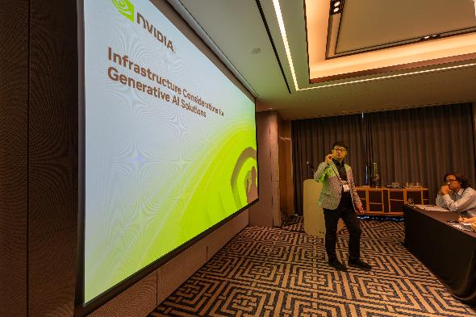
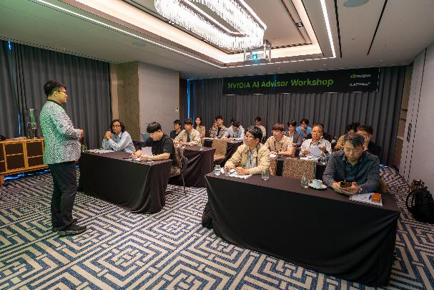
Session
Time | Session
08:30 – 09:00 | Registration
09:00 - 10:00 | Welcome & NVIDIA GTM
10:00 - 10:45 | Introduction to Generative Al and Large Language Models
10:45 - 11:00 | Break Time 1
11:00 - 12:00 | GenAl Use Cases - Activity-Based Industries Carousel
12:00 - 13:00 | Lunch
 | Sales Breakout | SE Breakout
13:00 - 14:30 | Targeting GenAI Opportunities – Group Activity | Infrastructure Considerations for GenAI Solutions
14:30 - 14:45 | Break Time 2
14:45 - 16:15 | Driving GenAI Success with NVIDIA-Based Solutions (Instructor-led) | GenAI development with NVIDIA Full-stack AI Platform
16:15 - 16:30 | Break Time 3 (merge)
16:30 - 17:15 | Interactive Demo & NVIDIA NGC Catalog Activity
17:15 - 17:30 | Joint Wrap Up
Infrastructure Considerations for GenAI Solutions

Slide 25
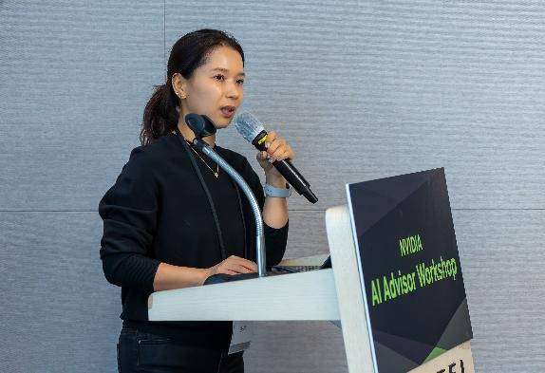
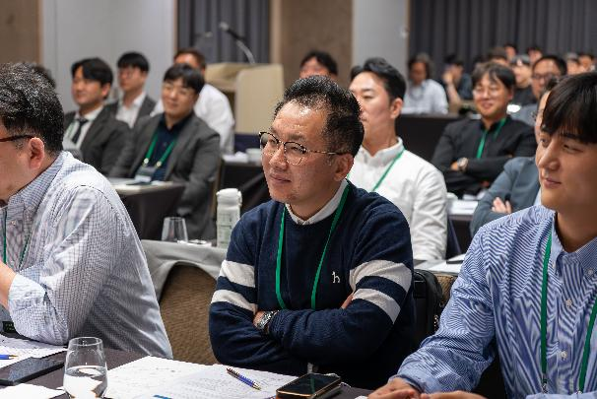
Session
Time | Session
08:30 – 09:00 | Registration
09:00 - 10:00 | Welcome & NVIDIA GTM
10:00 - 10:45 | Introduction to Generative Al and Large Language Models
10:45 - 11:00 | Break Time 1
11:00 - 12:00 | GenAl Use Cases - Activity-Based Industries Carousel
12:00 - 13:00 | Lunch
 | Sales Breakout | SE Breakout
13:00 - 14:30 | Targeting GenAI Opportunities – Group Activity | Infrastructure Considerations for GenAI Solutions
14:30 - 14:45 | Break Time 2
14:45 - 16:15 | Driving GenAI Success with NVIDIA-Based Solutions (Instructor-led) | GenAI development with NVIDIA Full-stack AI Platform
16:15 - 16:30 | Break Time 3 (merge)
16:30 - 17:15 | Interactive Demo & NVIDIA NGC Catalog Activity
17:15 - 17:30 | Joint Wrap Up
Driving GenAI Success with NVIDIA-Based Solutions (Instructor-led)

Slide 26
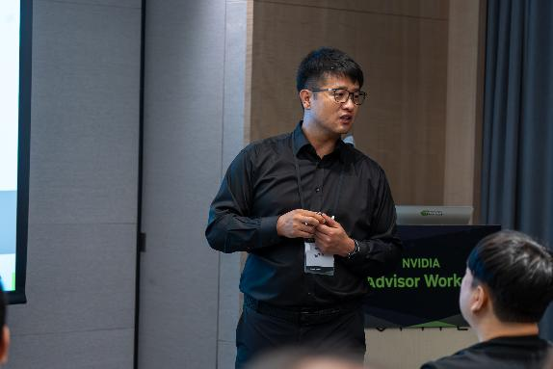
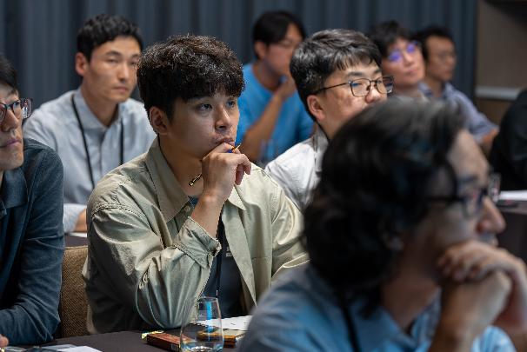
Session
Time | Session
08:30 – 09:00 | Registration
09:00 - 10:00 | Welcome & NVIDIA GTM
10:00 - 10:45 | Introduction to Generative Al and Large Language Models
10:45 - 11:00 | Break Time 1
11:00 - 12:00 | GenAl Use Cases - Activity-Based Industries Carousel
12:00 - 13:00 | Lunch
 | Sales Breakout | SE Breakout
13:00 - 14:30 | Targeting GenAI Opportunities – Group Activity | Infrastructure Considerations for GenAI Solutions
14:30 - 14:45 | Break Time 2
14:45 - 16:15 | Driving GenAI Success with NVIDIA-Based Solutions (Instructor-led) | GenAI development with NVIDIA Full-stack AI Platform
16:15 - 16:30 | Break Time 3 (merge)
16:30 - 17:15 | Interactive Demo & NVIDIA NGC Catalog Activity
17:15 - 17:30 | Joint Wrap Up
GenAI development with NVIDIA Full-stack AI Platform

Slide 27
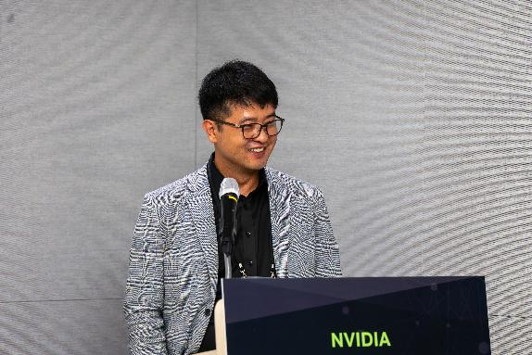
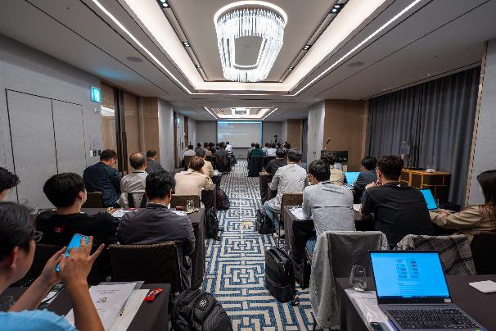
Session
Time | Session
08:30 – 09:00 | Registration
09:00 - 10:00 | Welcome & NVIDIA GTM
10:00 - 10:45 | Introduction to Generative Al and Large Language Models
10:45 - 11:00 | Break Time 1
11:00 - 12:00 | GenAl Use Cases - Activity-Based Industries Carousel
12:00 - 13:00 | Lunch
 | Sales Breakout | SE Breakout
13:00 - 14:30 | Targeting GenAI Opportunities – Group Activity | Infrastructure Considerations for GenAI Solutions
14:30 - 14:45 | Break Time 2
14:45 - 16:15 | Driving GenAI Success with NVIDIA-Based Solutions (Instructor-led) | GenAI development with NVIDIA Full-stack AI Platform
16:15 - 16:30 | Break Time 3 (merge)
16:30 - 17:15 | Interactive Demo & NVIDIA NGC Catalog Activity
17:15 - 17:30 | Joint Wrap Up
Interactive Demo & NVIDIA NGC Catalog Activity

Slide 28
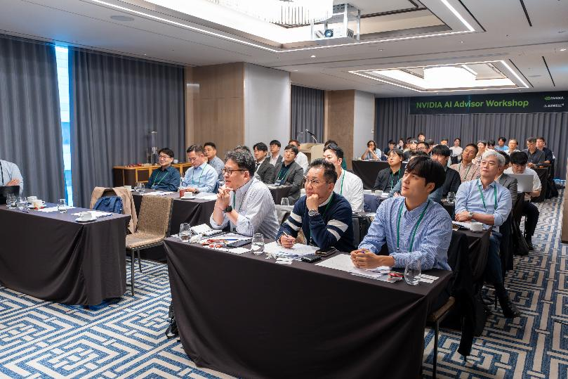
Session
Time | Session
08:30 – 09:00 | Registration
09:00 - 10:00 | Welcome & NVIDIA GTM
10:00 - 10:45 | Introduction to Generative Al and Large Language Models
10:45 - 11:00 | Break Time 1
11:00 - 12:00 | GenAl Use Cases - Activity-Based Industries Carousel
12:00 - 13:00 | Lunch
 | Sales Breakout | SE Breakout
13:00 - 14:30 | Targeting GenAI Opportunities – Group Activity | Infrastructure Considerations for GenAI Solutions
14:30 - 14:45 | Break Time 2
14:45 - 16:15 | Driving GenAI Success with NVIDIA-Based Solutions (Instructor-led) | GenAI development with NVIDIA Full-stack AI Platform
16:15 - 16:30 | Break Time 3 (merge)
16:30 - 17:15 | Interactive Demo & NVIDIA NGC Catalog Activity
17:15 - 17:30 | Joint Wrap Up
Joint Wrap Up

Slide 29
Session Day-2

Slide 30
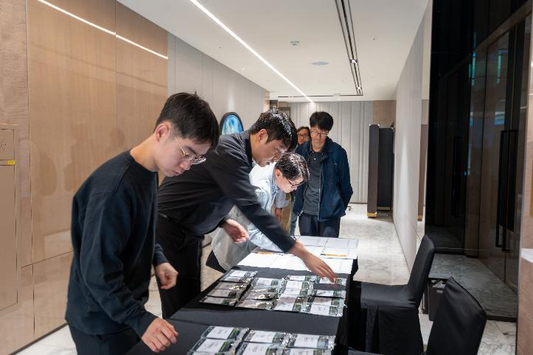
Session
Time | Session
08:30 – 09:00 | Registration
09:00 - 09:30 | Welcome
09:00 - 11:00 | Addressing the Buyer’s Journey (Instructor-led)
11:00 - 11:15 | Break Time 1
11:15 - 12:15 | Processes to Influence and Accelerate Customer Decisions (Instructor-led)
12:15 - 13:15 | Lunch
13:15 - 14:30 | Activity-Based Case Study Part 1 – Team Meeting
14:30 - 16:00 | Activity-Based Team Case Study Part 2 – Role Play
16:00 – 16:15 | Break Time 2
16:15 - 17:00 | Group Feedback & Discussion
17:00 – 17:30 | Final Reflections & Farewell Address – NVIDIA and Dell, “Better Together”
Registration

Slide 31
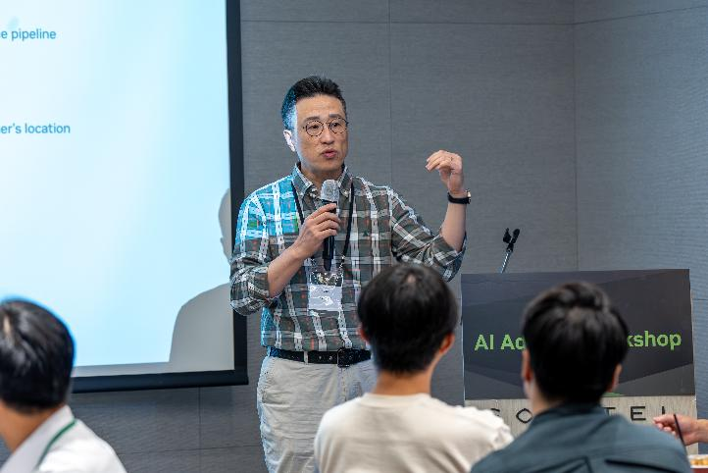
Session
Time | Session
08:30 – 09:00 | Registration
09:00 - 09:30 | Welcome
09:00 - 11:00 | Addressing the Buyer’s Journey (Instructor-led)
11:00 - 11:15 | Break Time 1
11:15 - 12:15 | Processes to Influence and Accelerate Customer Decisions (Instructor-led)
12:15 - 13:15 | Lunch
13:15 - 14:30 | Activity-Based Case Study Part 1 – Team Meeting
14:30 - 16:00 | Activity-Based Team Case Study Part 2 – Role Play
16:00 – 16:15 | Break Time 2
16:15 - 17:00 | Group Feedback & Discussion
17:00 – 17:30 | Final Reflections & Farewell Address – NVIDIA and Dell, “Better Together”
Welcome

Slide 32
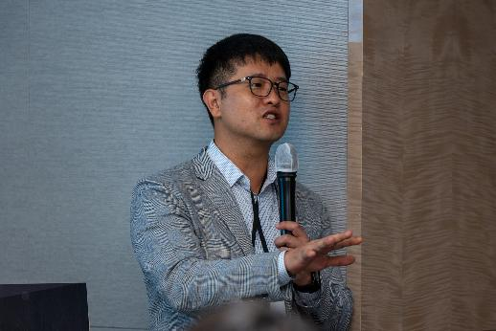
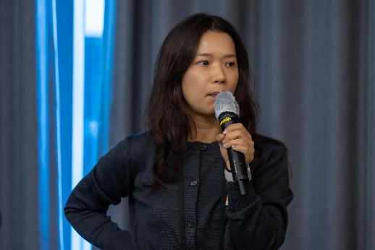
Session
Time | Session
08:30 – 09:00 | Registration
09:00 - 09:30 | Welcome
09:00 - 11:00 | Addressing the Buyer’s Journey (Instructor-led)
11:00 - 11:15 | Break Time 1
11:15 - 12:15 | Processes to Influence and Accelerate Customer Decisions (Instructor-led)
12:15 - 13:15 | Lunch
13:15 - 14:30 | Activity-Based Case Study Part 1 – Team Meeting
14:30 - 16:00 | Activity-Based Team Case Study Part 2 – Role Play
16:00 – 16:15 | Break Time 2
16:15 - 17:00 | Group Feedback & Discussion
17:00 – 17:30 | Final Reflections & Farewell Address – NVIDIA and Dell, “Better Together”
Addressing the Buyer’s Journey (Instructor-led)

Slide 33
Sketch

Slide 34
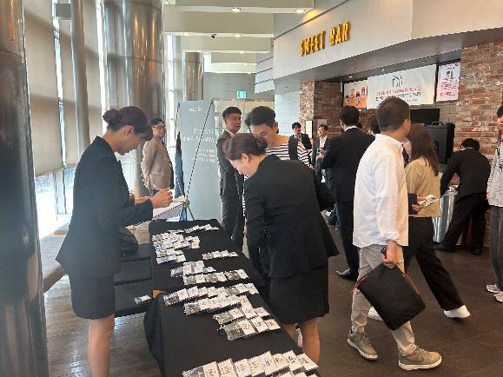
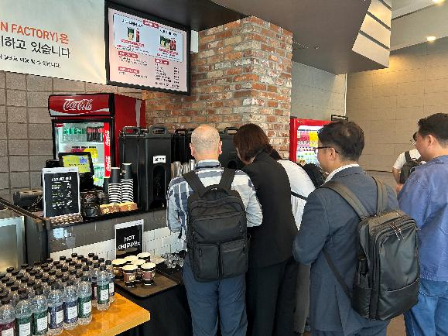
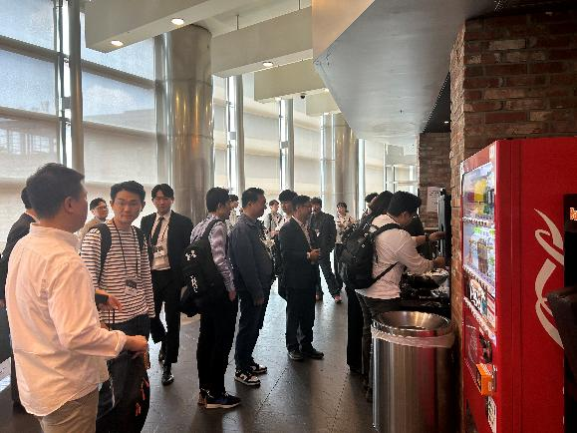
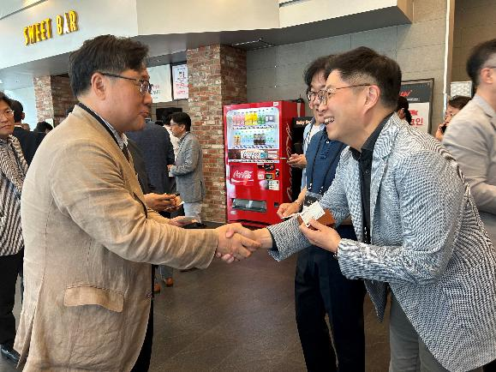
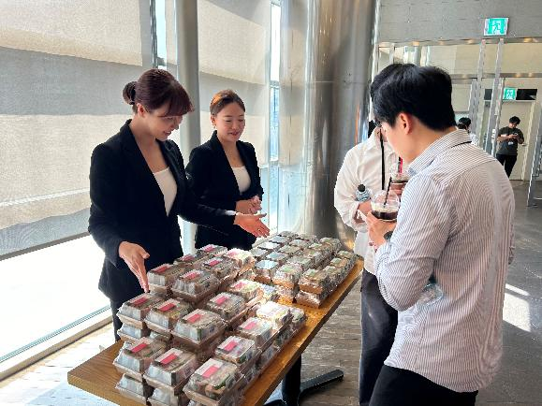
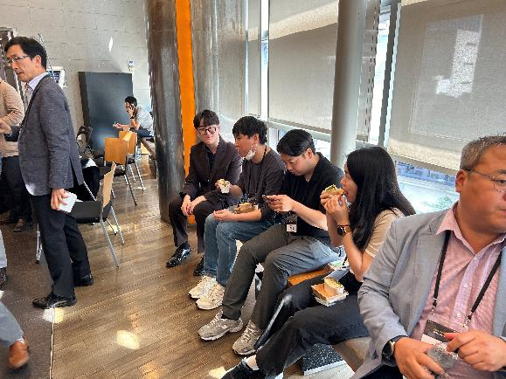
Sketch

Slide 35
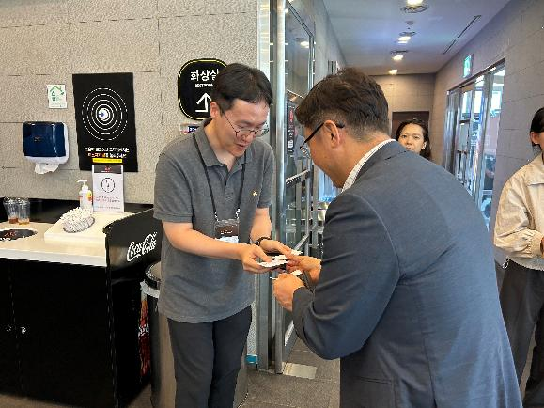
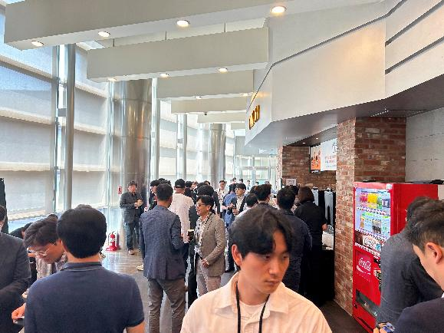




Sketch

Slide 36
Invoice

Slide 37

Invoice - Summary

Slide 38

Invoice (1/2)

Slide 39

Invoice (2/2)

Slide 40


2. Venue (F&B included)

Slide 41



2. Venue (F&B included)
ㆍ대관비 선금 – 11,072,727
ㆍ대관비 중도금 (세금계산서 발행 불가) – 2,214,545
ㆍ대관비 잔금 – 3,162,000 중 1,854,364

Slide 42

2. Venue (F&B included)
4,784,000
ㆍF&B – 3,476,364
ㆍF&B 잔금 – 3,162,000 중 1,307,636

Slide 43


3. A/V eqipment rental, banner, lanyard production&operation

Slide 44

4. Staff outsourcing

Slide 45

5. Miscellaneous (1/3)
ㆍ세부 내역
구분 | 항목 | 금액 | 비고
운영비 | 주차비 | 145,000 | 5인 주차비용 결제
운영비 | 비품 - 테이프류 | 7,980
운영비 | 스테프 간식 | 10,600
운영비 | 스테프 점심 | 27,800
운영비 | 물품 운송비 (세팅) | 30,000
운영비 | 물품 운송비 (철수) | 30,000
Total |  | 251,380

Slide 46


5. Miscellaneous (2/3)
ㆍ스텝 간식, 점심비용
ㆍ세부 내역
ㆍ비품 - 테이프류
구분 | 항목 | 금액 | 비고
운영비 | 주차비 | 145,000 | 5인 주차비용 결제
운영비 | 비품 - 테이프류 | 7,980
운영비 | 스테프 간식 | 10,600
운영비 | 스테프 점심 | 27,800
운영비 | 물품 운송비 (세팅) | 30,000
운영비 | 물품 운송비 (철수) | 30,000
Total |  | 251,380

Slide 47

5. Miscellaneous (3/3)
ㆍ세부 내역
구분 | 항목 | 금액 | 비고
운영비 | 주차비 | 145,000 | 5인 주차비용 결제
운영비 | 비품 - 테이프류 | 7,980
운영비 | 스테프 간식 | 10,600
운영비 | 스테프 점심 | 27,800
운영비 | 물품 운송비 (세팅) | 30,000
운영비 | 물품 운송비 (철수) | 30,000
Total |  | 251,380

Slide 48
EOD

